Slide 1

final Presentation
piggybudget

Slide 2
Members
107598002 唐振嚴
107598012 林佳緯
107598043 周士禾
107598053 邱楹傑

Slide 3

Outline
1. Abstract
2. Test criteria
3. The methods used to design test cases
4. All test cases
5. Sample test cases
6. Test Tools to be used
7. Demo video
8. Result of the tests
9. Analysis the results
10. Project activities and Schedule
11. Responsibility of team members

Slide 4
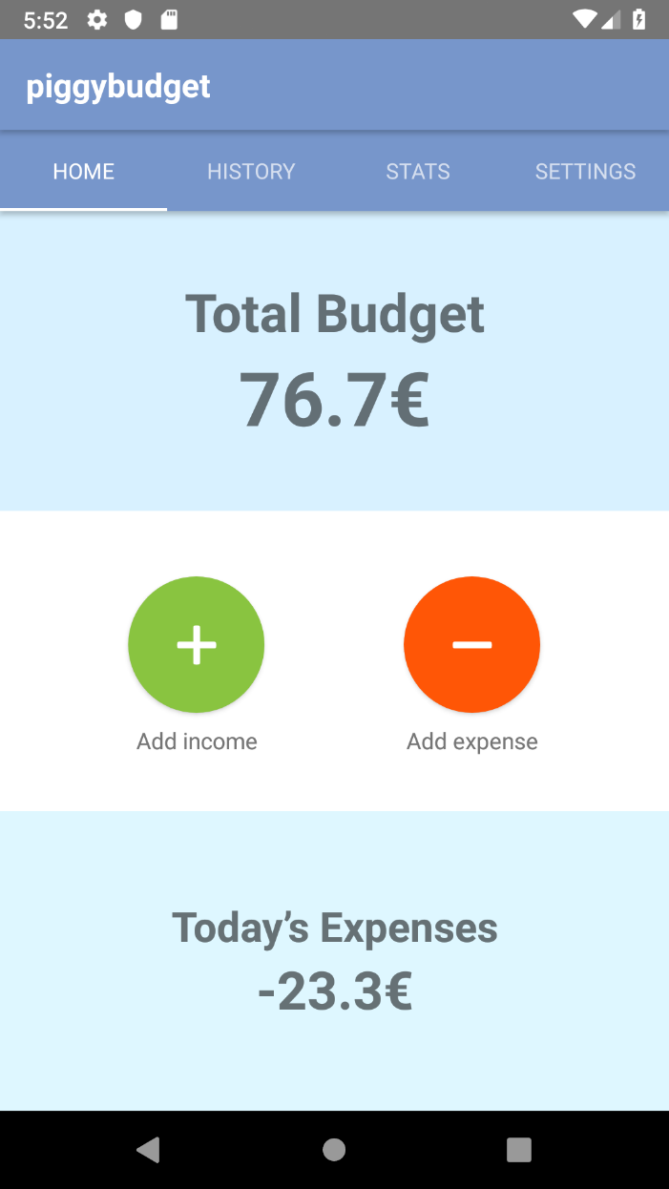
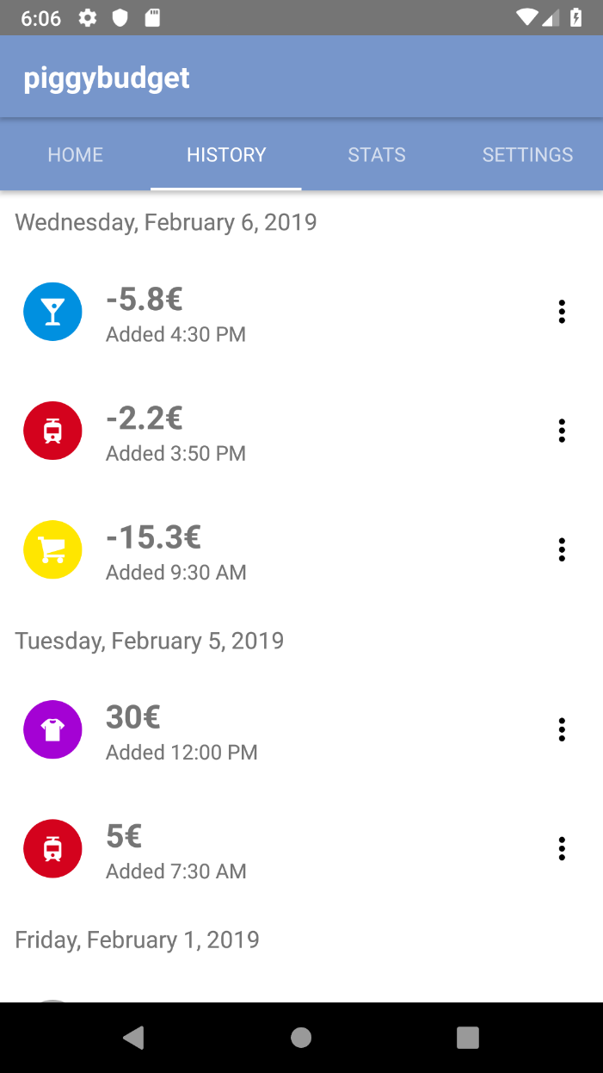
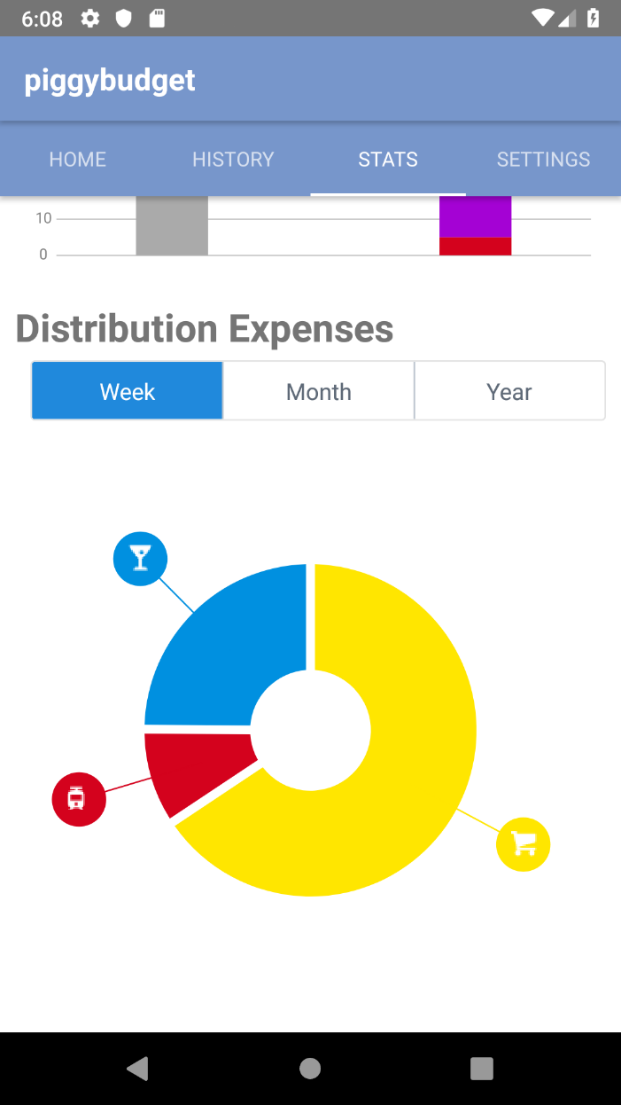
1. abstract

Slide 5

The thing test criteria based on - ACE
ACE is a well-known system that can crawl the apps states.
ACE can produce the StateTransitionDiagram that shows the states been crawled and the actions been taken.

Slide 6
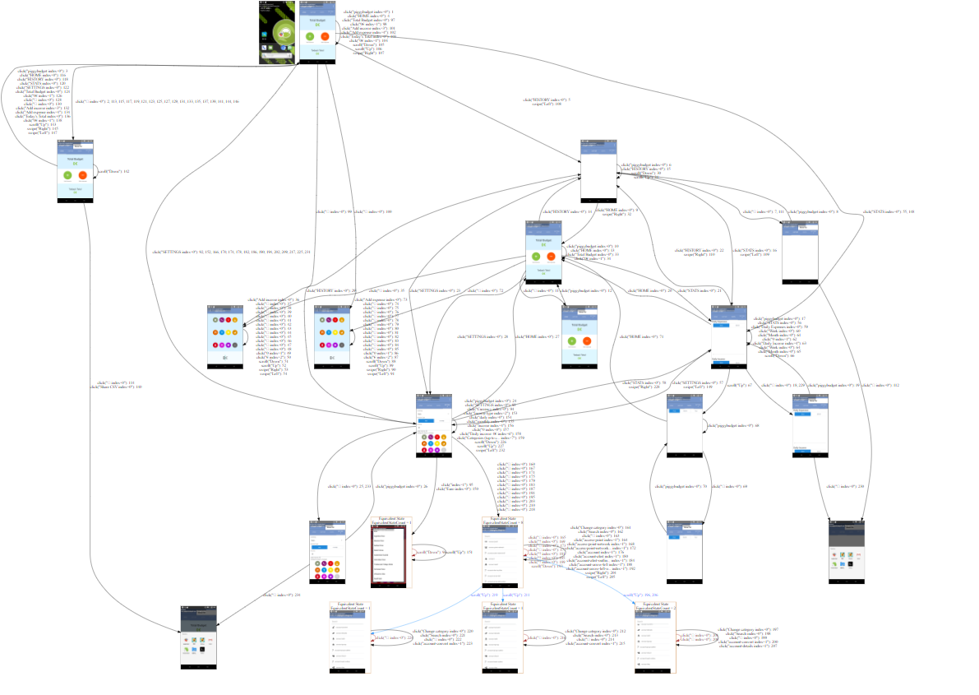
The thing test criteria based on - ACE

Slide 7


2. test criteria
Pass – Our test cases designed using ISP and User scenario are satisfied with the result crawled by ACE.
Fail – If the failed items are more than 2, test criteria is unqualified.

Slide 8
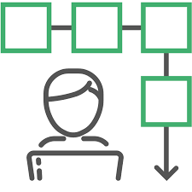
3. The methods used to design test cases
User scenario – We designed our test cases based on the actions done by our team members who told to at least go through all main activities.
ISP(Input Space Partitioning) – We used this technique taught in class to design, hoping to increase coverage.

Slide 9
4. All test cases and features been covered – user scenario
Test suite | Test cases | Features satisfied
test_home | test_case_expense | expense
 | test_case_income | income
 | test_case_expense_zero | expense
 | test_case_income_zero | income
 | test_case_expense_txt | expense
test_history | test_case_add_and_check | History data
 | test_case_edit_history | history
 | test_case_make_expense | History make expense
 | test_case_delete | History delete
 | test_case_no_delete | History delete
test_settings | test_changecurrencytoMexicanPeso | Change currency
 | test_checkCurrency | Currency
 | test_income | Currency

Slide 10
4. All test cases and features been covered – user scenario
Test suite | Test cases | Features satisfied
test_stats | test_daily_expenses_button_week | Whether crash
 | test_daily_expenses_button_month | Whether crash
 | test_daily_income_button_week | Whether crash
 | test_daily_income_button_month | Whether crash
 | test_daily_distribution_button_week | Whether crash
 | test_daily_distribution_button_month | Whether crash
 | test_daily_distribution_button_year | Whether crash

Slide 11
4. All test cases – ISP
Page | Method | Characteristic ID | Characteristic Description | Partitions(Blocks)
Home | add income->輸入金額 | C1, C2, C3,C4 | C1: 輸入的金額是合法數字 C2: 輸入的金額是整數 C3: 輸入的金額是正數(A)、零(B)、負數(C) C4: 輸入的金額長度小於20 | C1:{T, F} C2:{T, F} C3:{A, B, C} C4:{T, F}
Home | add expense->輸入金額 | C1, C2, C3,C4 | C1: 輸入的金額是合法數字 C2: 輸入的金額是整數 C3: 輸入的金額是正數(A)、零(B)、負數(C) C4: 輸入的金額長度小於20 | C1:{T, F} C2:{T, F} C3:{A, B, C} C4:{T, F}
History | Edit->輸入金額 | C1, C2, C3,C4 | C1: 輸入的金額是合法數字 C2: 輸入的金額是整數 C3: 輸入的金額是正數(A)、零(B)、負數(C) C4: 輸入的金額長度小於20 | C1:{T, F} C2:{T, F} C3:{A, B, C} C4:{T, F}
History | Delete->dialog | C1 | C1: 點擊DELETE | C1:{T, F}
Setting | Income | C1, C2, C3,C4 | C1: 輸入的金額是合法數字 C2: 輸入的金額是整數 C3: 輸入的金額是正數(A)、零(B)、負數(C) C4: 輸入的金額長度小於20 | C1:{T, F} C2:{T, F} C3:{A, B, C} C4:{T, F}
Setting | Categories->Search | C1 | C1: 輸入的字串完全符合現存的分類(A)、符合部分名字(B)、不符合(C) | C1:{A, B, C}

Slide 12
4. All test cases – ISP
Home
test_case_expense_bigger20() | test_case_income_bigger20()
test_case_expense_negative_bigger20() | test_case_income_decimal_negative()
test_case_expense_decimal_negative_bigger20() | test_case_income_decimal()
test_case_expense_decimal_bigger20() | test_case_income_negative()
test_case_expense_negative() | test_case_expense_zero_decimal()
test_case_expense_decimal_negative() | test_case_expense_zero_decimal_without_digits()
test_case_expense_decimal() | test_case_income_zero_decimal()
test_case_income_decimal_negative_bigger20() | test_case_income_zero_decimal_without_digits()
test_case_income_decimal_bigger20() | test_case_expense_txt()
test_case_income_negative_bigger20()

Slide 13
4. All test cases – ISP
History
test_case_add_and_check_income() | test_case_add_and_check_income_negative_bigger20()
test_case_add_and_check_expense_bigger20() | test_case_add_and_check_income_bigger20()
test_case_add_and_check_expense_negative_bigger20() | test_case_add_and_check_income_decimal_negative()
test_case_add_and_check_expense_decimal_negative_bigger20() | test_case_add_and_check_income_decimal()
test_case_add_and_check_expense_decimal_bigger20() | test_case_add_and_check_income_negative()
test_case_add_and_check_expense_negative() | test_case_edit_history()
test_case_add_and_check_expense_decimal_negative() | test_case_make_expense()
test_case_add_and_check_expense_decimal() | test_case_delete()
test_case_add_and_check_income_decimal_negative_bigger20() | test_case_no_delete()
test_case_add_and_check_income_decimal_bigger20()

Slide 14
4. All test cases – ISP
Setting
test_case_change_income_bigger20()
test_case_change_income()
test_case_change_decimal_income()
test_case_change_income_negative()
test_case_change_decimal_income_negative()
test_case_change_income_zero()
test_case_change_icon_search_half_match()
test_case_change_icon_search_perfact_match()
test_case_change_icon_search_no_match()

Slide 15
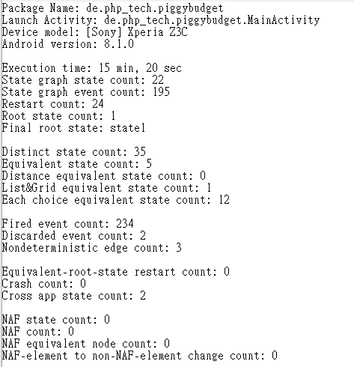
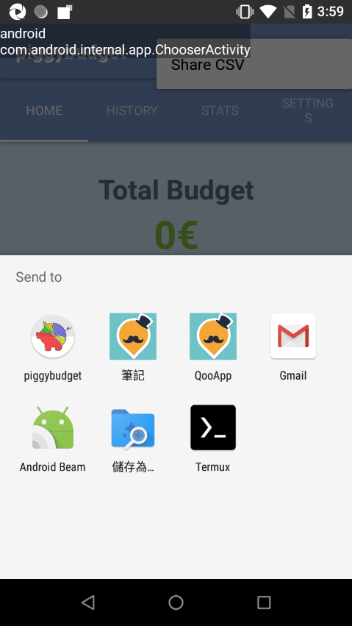
Ensure all test cases to cover the result of ACE
Our test cases：
Cover ACE
State graph state count: 21
State graph event count: 192

Slide 16

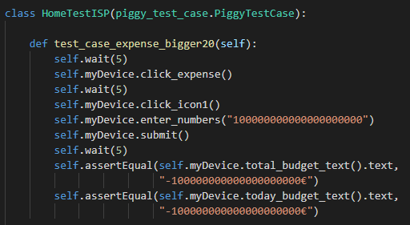
5. Sample test cases

Slide 17




6. Test Tools to be used

Slide 18
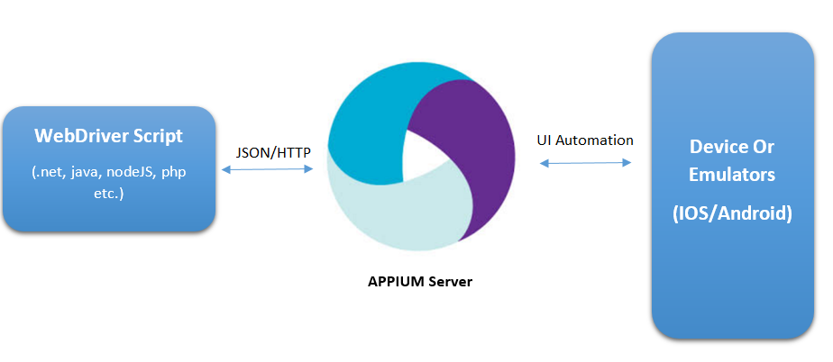
6. Test Tools to be used - Method

Slide 19

7. Demo video

Slide 20
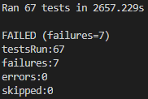
8. Result of the tests

Slide 21
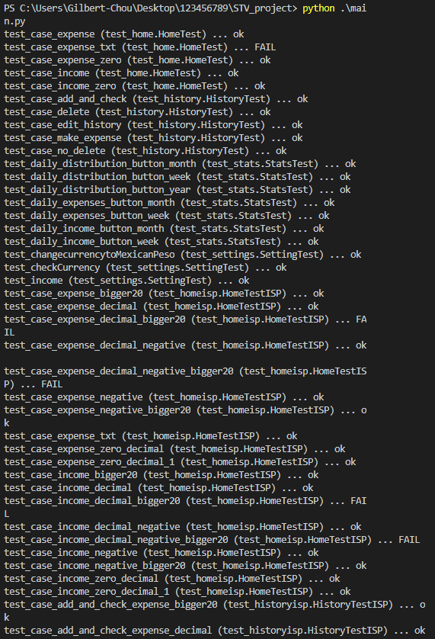
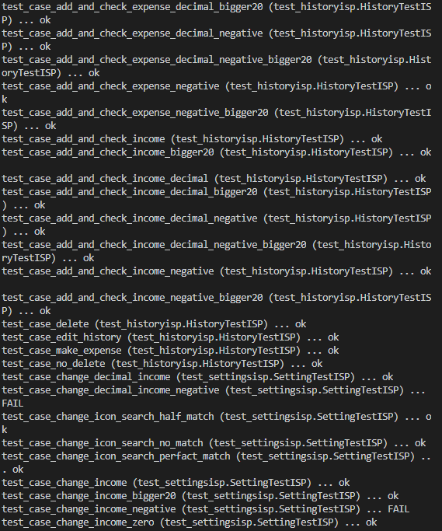
8. Result of the tests

Slide 22

The result of test criteria
After our research of the app, we found many failures in this app.
Users use this app inconveniently, and some results are not ideal.
We regard this app as a unqualified app.
We can analysis these problems in the down below.

Slide 23
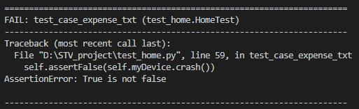
9. Analysis the results(1)
Test suite | Test cases | detail
test_home | test_case_expense_txt | 當在金額輸入文字時，測試會不會crash

Slide 24
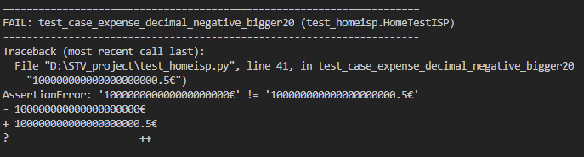
9. Analysis the results(2)
Test suite | Test cases | detail
test_homeisp | test_case_expense_decimal_bigger20 | 輸入20個零，在Home會顯示不出小數，但是在history裡面正常
 | test_case_expense_decimal_negative_bigger20 | 同上，負數情況
 | test_case_income_decimal_bigger20 | 同上，income情況
 | test_case_income_decimal_negative_bigger20 | 同上，負數情況

Slide 25
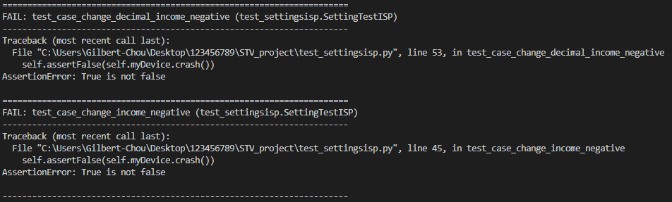
9. Analysis the results(3)
Test suite | Test cases | detail
test_settingsisp | test_case_change_income_negative | 當在income這裡輸入負數時，會crash
 | test_case_change_decimal_income_negative | 同上，有小數情況

Slide 26
10. Project activities and Schedule
No： | Date： | Hours： | Activities：
1 | 3/7(Thur) | 2 | Decide the app and tools
2 | 3/14(Thur) | 2 | Analysis features
3 | 3/21(Thur) | 3 | SUT
4 | 3/28(Thur) | 3 | Study the way of using appium
5 | 4/11(Thur) | 3 | Study python testing tools
6 | 4/18(Thur) | 3 | Cutting testing and separate work
7 | 4/22(Mon) | 3 | TDS、TCS
8 | 4/23(Tue) |  | Midterm presentation review

Slide 27
10. Project activities and Schedule
No： | Date： | Hours： | Activities：
1 | 5/2(Thur) | 2 | Problem with xpath, await
2 | 5/9(Thur) | 2 | Redesign ISP
3 | 5/16(Thur) | 4 | Review ISP, Rewrite test cases, Review TDS、TCS
4 | 5/23(Thur) | 3 | Review and rewrite test cases
5 | 6/6(Thur) | 2 | Review test cases, review result
6 | 6/15(Sat) | 2 | Review result
7 | 6/17(Mon) | 2 | Review all activities of the project
8 | 6/18(Tue) |  | Final presentation review

Slide 28
11. Responsibility of team members
107598002 唐振嚴 STP, test case, ideas
107598012 林佳緯 STP, TDS, test case, ISP, xpath,ppt
107598043 周士禾 STP, TCS, environment of unittest, test case, ISP
107598053 邱楹傑 STP, environment of unittest, test case, ppt, teamleader

